Slide 1
HOMEWORK 2 Due 03/14 00:00 send to e3

Slide 2

Use only uniform (0,1) random number to do the following.
1. (20%) Estimate via simulation.
2. (30%)

Slide 3
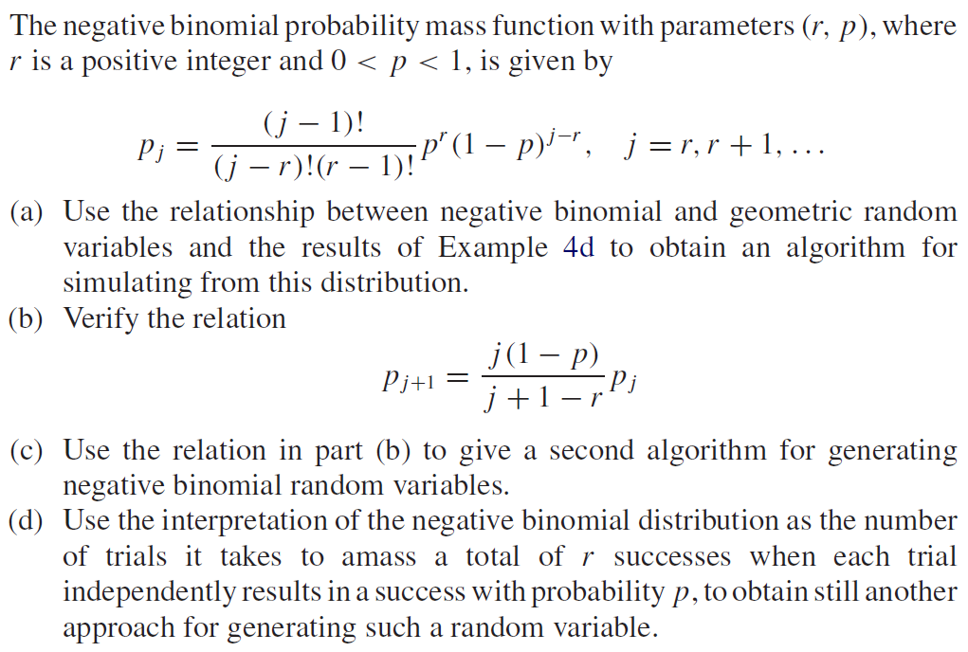
Use only uniform (0,1) random number to do the following.
3. (50%)

